Slide 1
Registers and Counters
Prepared By Dr. Sultan S. Alqahtani
CS106 Digital Logic

Slide 2
Content
Registers
1-bit and 4-bit registers
Shift Registers
Timing for shift registers
Counters
Up/Down counters
Other Counters
Summary

Slide 3
Registers
A register is a memory device that can be used to store more than one bit of information.
A register is a circuit capable of storing data. In general, an n-bit register consists of n FFs, together with some other logic that allows simple processing of the stored data.
A register is a generalization of a flip-flop. Where a flip-flop stores one bit, a register stores several bits

Slide 4
Registers
The main operations on a register are the same as for any storage devices, namely:
Load or Store: Put new data into the register
Read: Retrieve the data stored in the register (usually without changing the stored data).

Slide 5
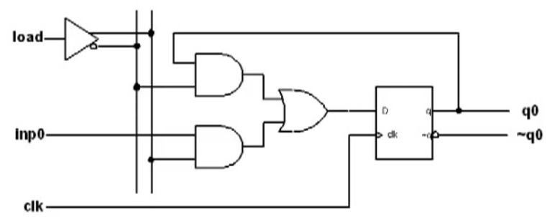
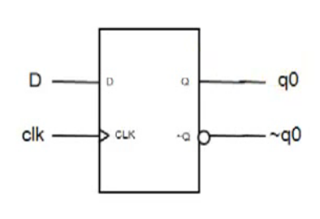
1-bit register
D Flip-Flop
1-bit register

Slide 6
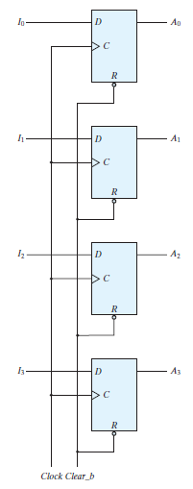
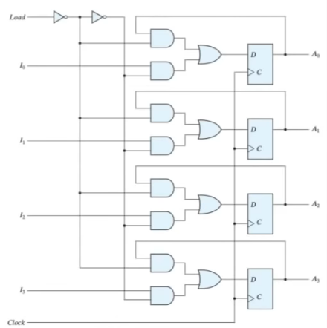
4-bit register

Slide 7
Cont.
The transfer of new information into a register is referred to as Loading.
The term Parallel Loading is used if all the input bits are transferred into the register simultaneously, with the common clock pulse.
In most digital systems, a master clock generator supplies clock pulses to all parts of the system, just as the heart that supplies a constant beat to all parts in the human system.
Because of this fact, the input values in the register are loaded when a clock pulse arrives.
This implies that, whenever a clock pulse arrives, it would load the register with new values, thus overwriting the previously stored register data.

Slide 8
Shift Register
A basic shift register is simply a chain of D flip-flops with a common clock.
Each flip-flop transfers its D input to its Q output at a clock transition.
The effect is to transfer data along the register, one flip-flop per clock cycle.
This type of register is called a serial input-serial output (SISO).
serial input
01001110
D Q
D Q
D Q
D Q
serial output
A
B
C
D
clock

Slide 9
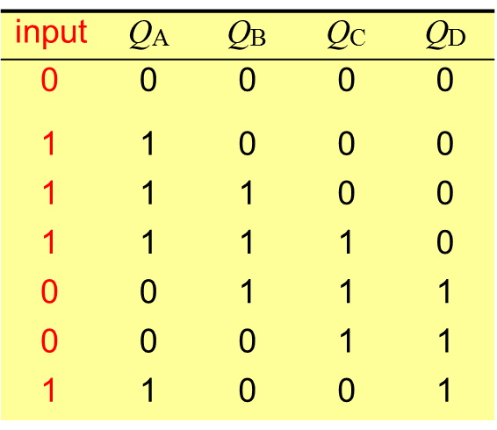

Shift Register
A basic shift register is simply a chain of D flip-flops with a common clock.
serial input
01001110
D Q
D Q
D Q
D Q
serial output
A
B
C
D
clock
The table shows the contents of the register after successive clock transitions. The assumption is that the register is initially clear.
The number of clock pulses needed to fill the register is equal to the number of flip-flops used to make the register. This is a 4 bit register.
clock pulses
0
0
1
0
0

Slide 10
Timing for a shift register
clock
input
QA QB QC
QD
tpd
The pattern in successive flip-flops moves to the right with each clock cycle to shift the pattern into and out of the register.

Slide 11
Timing for a shift register
clock
input
QA QB QC
input
QA QB QC
QD
QD
0
0
0
0
0
0
0
0
tpd
1
1
1
1
1
1
0
1
1
0
0
1
0
0
1
1
1

Slide 12
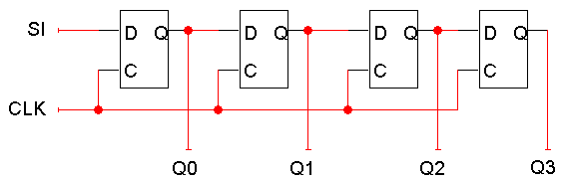
Shift registers
A shift register “shifts” its output once every clock cycle.
SI is an input that supplies a new bit to shift “into” the register. For example, if on some positive clock edge we have:
SI = 1
Q₀-Q₃ = 0110
then the next state will be:
Q₀-Q₃ = 1011
The current Q₃ (0 in this example) will be lost on the next cycle.
Q₀(t+1) = SI
Q₁(t+1) = Q₀(t)
Q₂(t+1) = Q₁(t)
Q₃(t+1) = Q₂(t)

Slide 13
Shift direction
Q₀(t+1) = SI
Q₁(t+1) = Q₀(t)
Q₂(t+1) = Q₁(t)
Q₃(t+1) = Q₂(t)
The circuit and example make it look like the register shifts “right.”
But it really depends on your interpretation of the bits. If you consider Q3 to be the most significant bit instead, then the register is shifting in the opposite direction!

Slide 14
Application of a basic shift register
Multiplication and division by powers of 2, because this just requires a shift of the binary number (like multiplication or division by 10 in decimal)
Example: decimal 3 x 4 = 12 becomes 11 x 100 = 1100 in binary. The arithmetic logic unit (ALU) of a computer processor uses a shift register for this purpose.
The ‘sense’ of a shift — left or right — is usually based on its effect on binary numbers written in the usual way.
To multiply 3x4, take 0011, shift left by 2, get 1100 (12).
To divide 27 by 8, take 00011011, shift right by 3, get 00000011 (3) (we lose the fraction).

Slide 15
Counters
A counter is a register capable of incrementing and/or decrementing its contents
Counters are a specific type of sequential circuit
Counters are available in two types:
– Synchronous Counters
– Ripple Counters
Synchronous Counters:
– A common clock signal is connected to the C input of each flip-flop

Slide 16
Benefits of counters
Counters can act as simple clocks to keep track of “time.”
You may need to record how many times something has happened.
How many bits have been sent or received?
How many steps have been performed in some computation?
All processors contain a program counter, or PC.
Programs consist of a list of instructions that are to be executed one after another (for the most part).
The PC keeps track of the instruction currently being executed.
The PC increments once on each clock cycle, and the next program instruction is then executed.

Slide 17
2-bit Up/Down counter
– Counter outputs will be 00, 01, 10 and 11
– There is a single input, X.
> X= 0, the counter counts up
> X= 1, the counter counts down
•We’ll need two flip-flops again. Here are the four possible states:
00
01
11
10

Slide 18
The complete state diagram and table
Here’s the complete state diagram and state table for this circuit
0
00
01
1
0
1
1
0
1
11
10
0

Slide 19
D flip-flop inputs
If we use D flip-flops, then the D inputs will just be the same as the desired next states
Equations for the D flip-flop inputs are shown at the right
D₁ = Q₁ ⊕ Q₀ ⊕ X
D₀ = Q₀’

Slide 20
JK flip-flop inputs
If we use JK flip-flops instead, then we have to compute the JK inputs for each flip-flop.
Look at the present and desired next state, and use the excitation table on the right.

Slide 21
JK flip-flop input equations
We can then find equations for all four flip-flop inputs, in terms of the present state and inputs. Here, it turns out J₁ = K₁ and J₀ = K₀.
J₁ = K₁ = Q₀’ X + Q₀ X’
J₀ = K₀ = 1

Slide 22
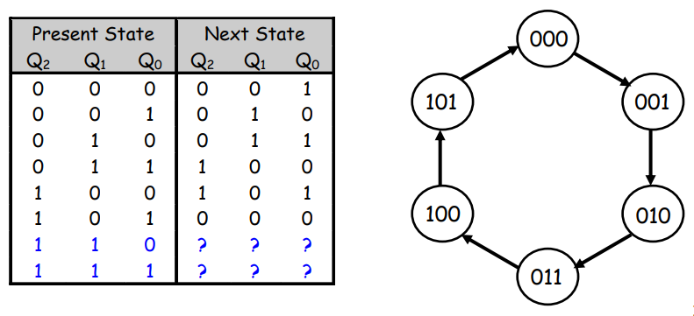
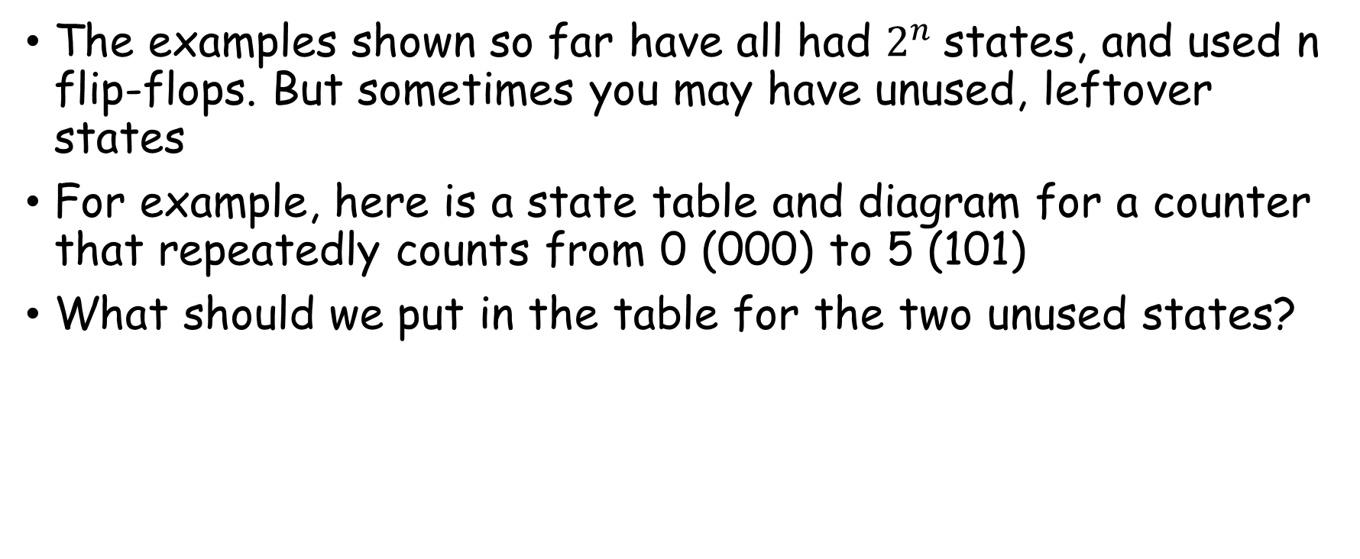
Unused states
The examples shown so far have all had $2^{n}$states, and used n flip-flops. But sometimes you may have unused, leftover states
For example, here is a state table and diagram for a counter that repeatedly counts from 0 (000) to 5 (101)
What should we put in the table for the two unused states?

Slide 23
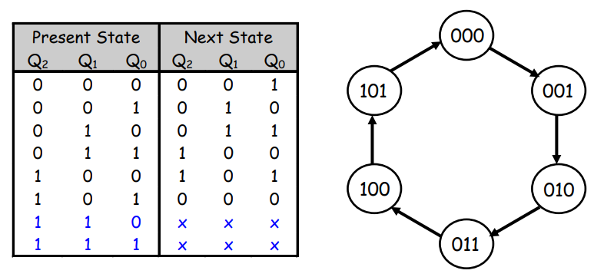
Unused states can be don’t cares…
To get the simplest possible circuit, you can fill in don’t cares for the next states. This will also result in don’t cares for the flip-flop inputs, which can simplify the hardware
If the circuit somehow ends up in one of the unused states (110 or 111), its behavior will depend on exactly what the don’t cares were filled in with

Slide 24
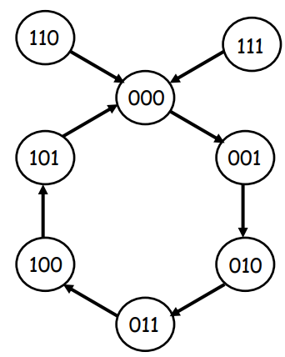
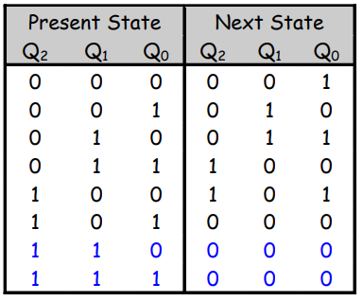
…or maybe you do care
To get the safest possible circuit, you can explicitly fill in next states for the unused states 110 and 111
This guarantees that even if the circuit somehow enters an unused state, it will eventually end up in a valid state
This is called a self-starting counter

Slide 25
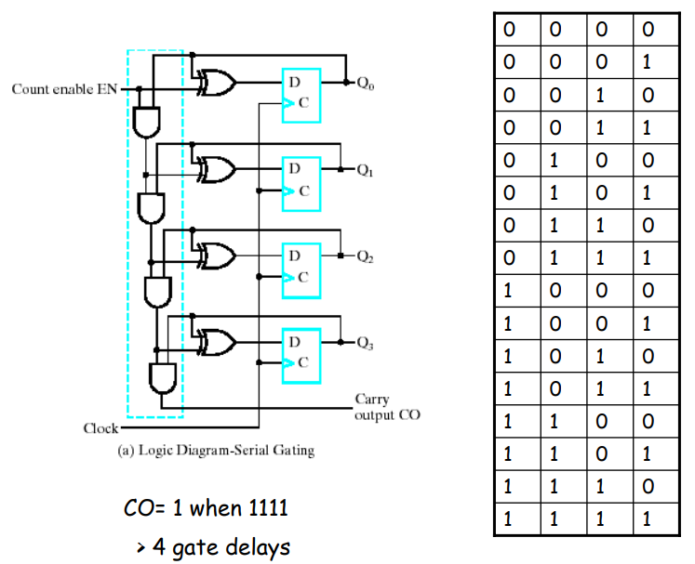
4-bit Counter with Serial Gating

Slide 26
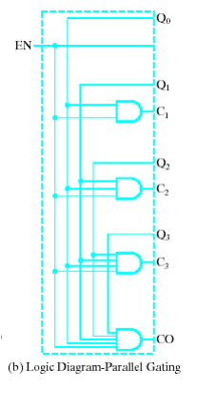
4-bit Counter with Parallel Gating

Slide 27
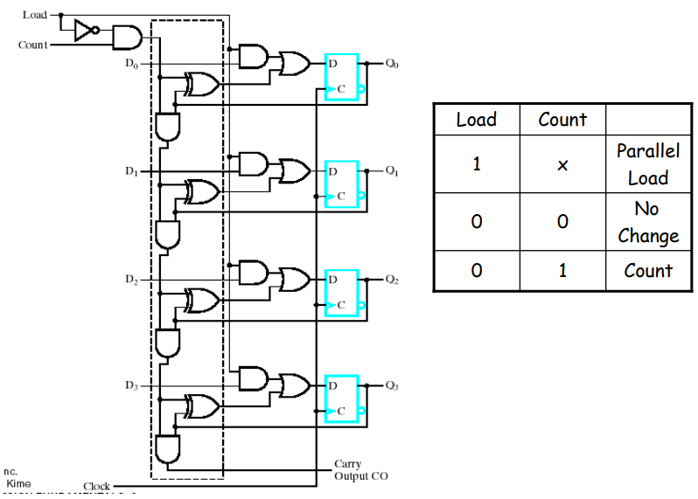
4-bit Binary Counter with Parallel Load

Slide 28
Summary of Counters
Counters serve many purposes in sequential logic design.
There are lots of variations on the basic counter.
Some can increment or decrement.
An enable signal can be added.
The counter’s value may be explicitly set.
There are also several ways to make counters.
You can follow the sequential design principles to build counters from scratch.
You could also modify or combine existing counter devices.

